Slide 1
Managing Tables Using DML Statements

Slide 2
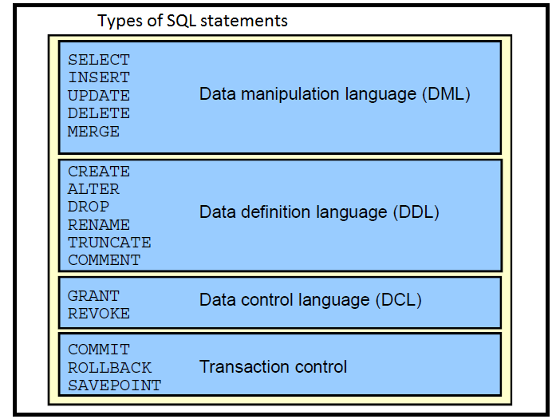

Slide 3
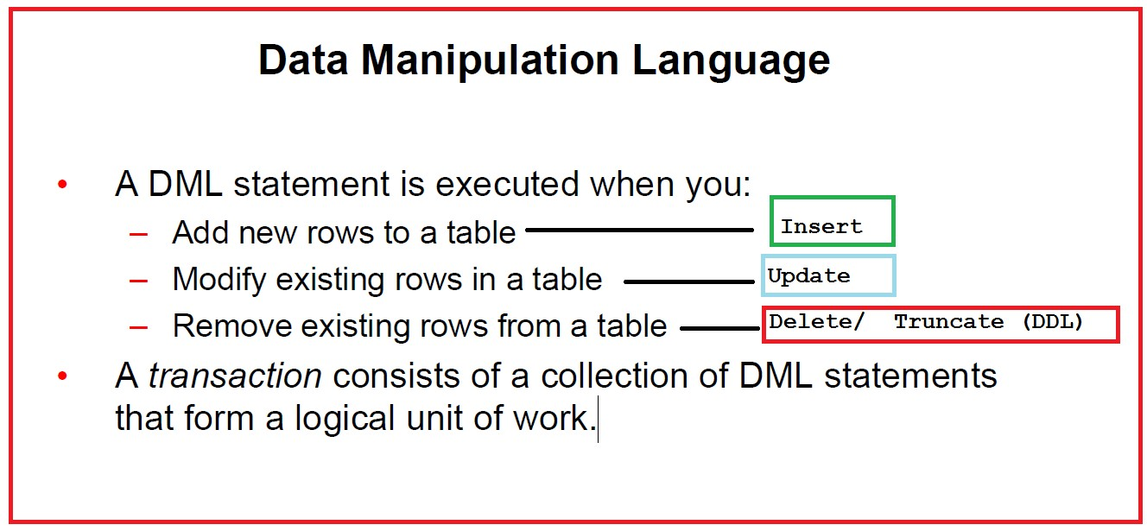

Slide 4
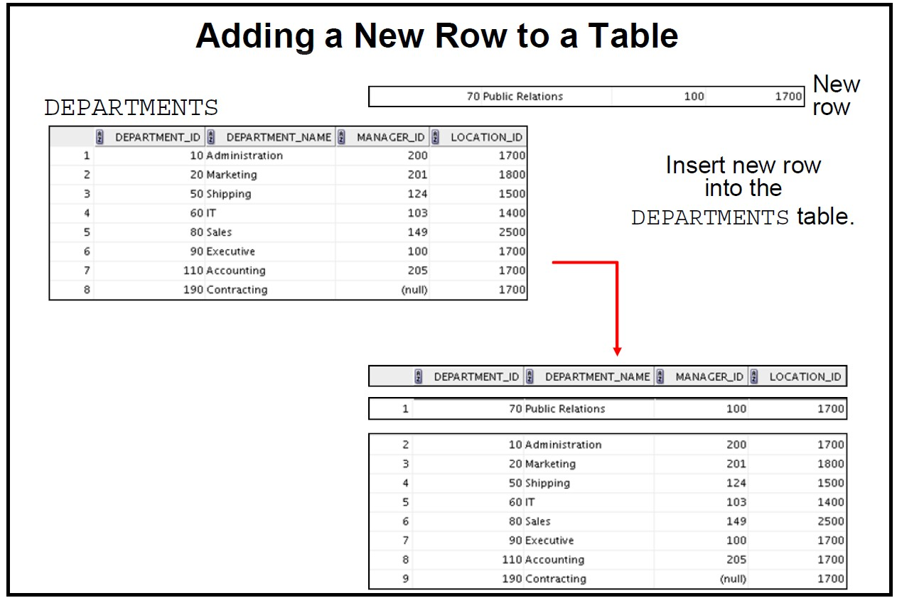

Slide 5
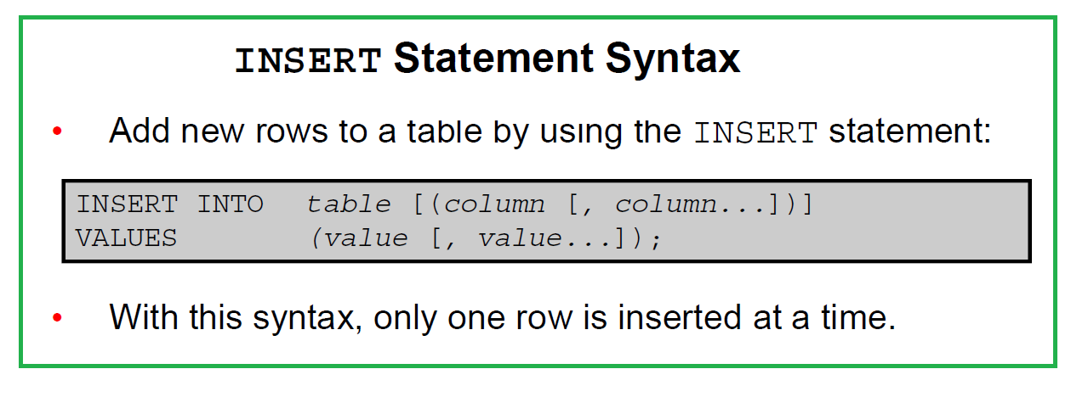

Slide 6
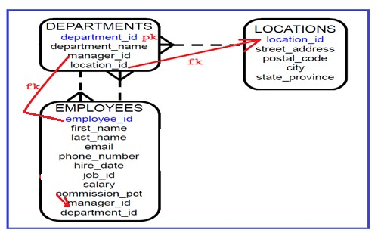
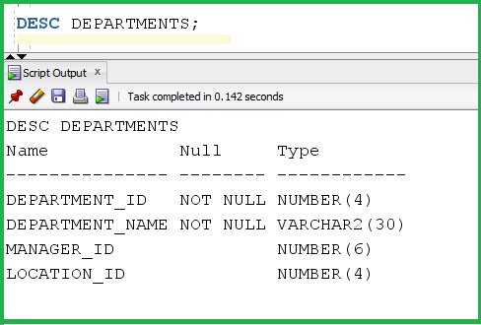
1- You should know the table structure before you make any insert
2- you should know also the constraints on the table

Slide 7
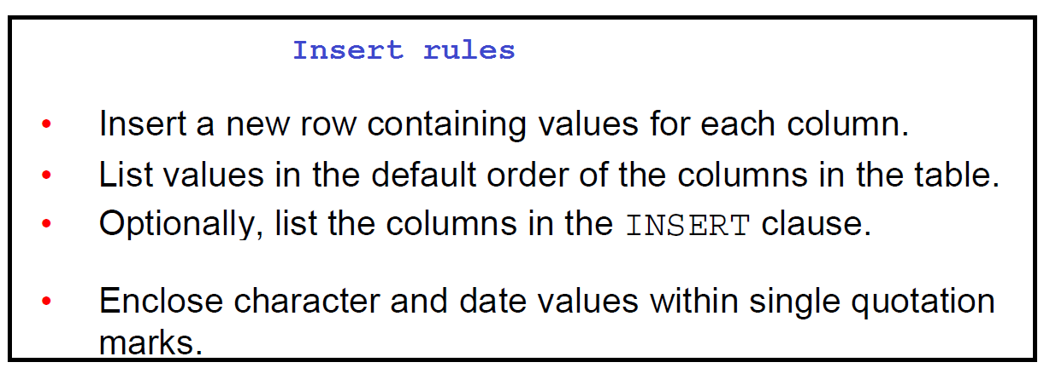

Slide 8
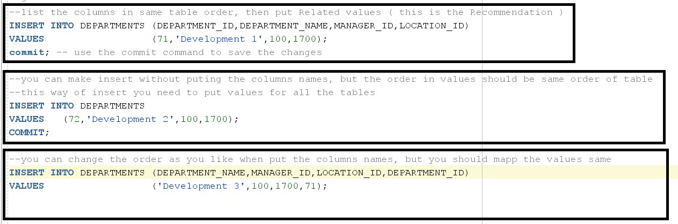

Slide 9
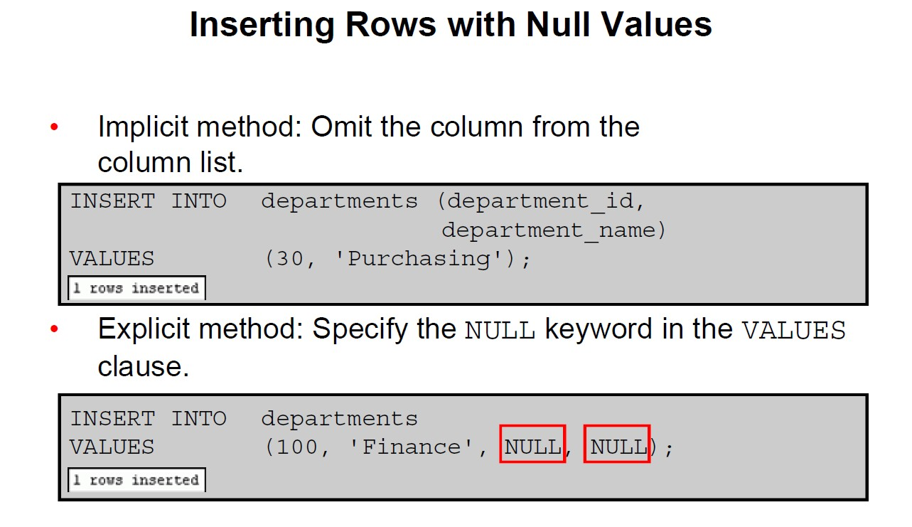

Slide 10
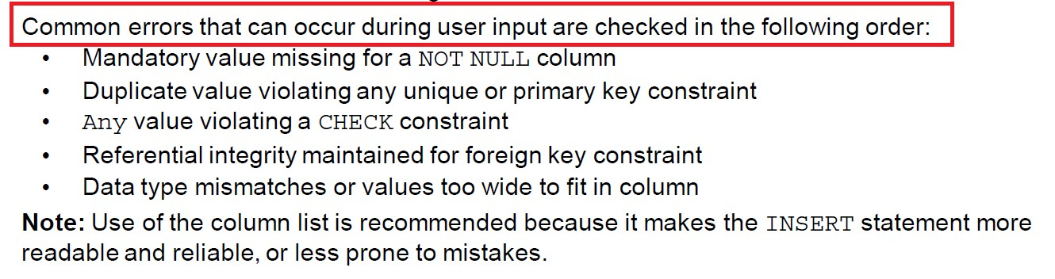

Slide 11
Inserting special values like sysdate, or some other functions

Slide 12
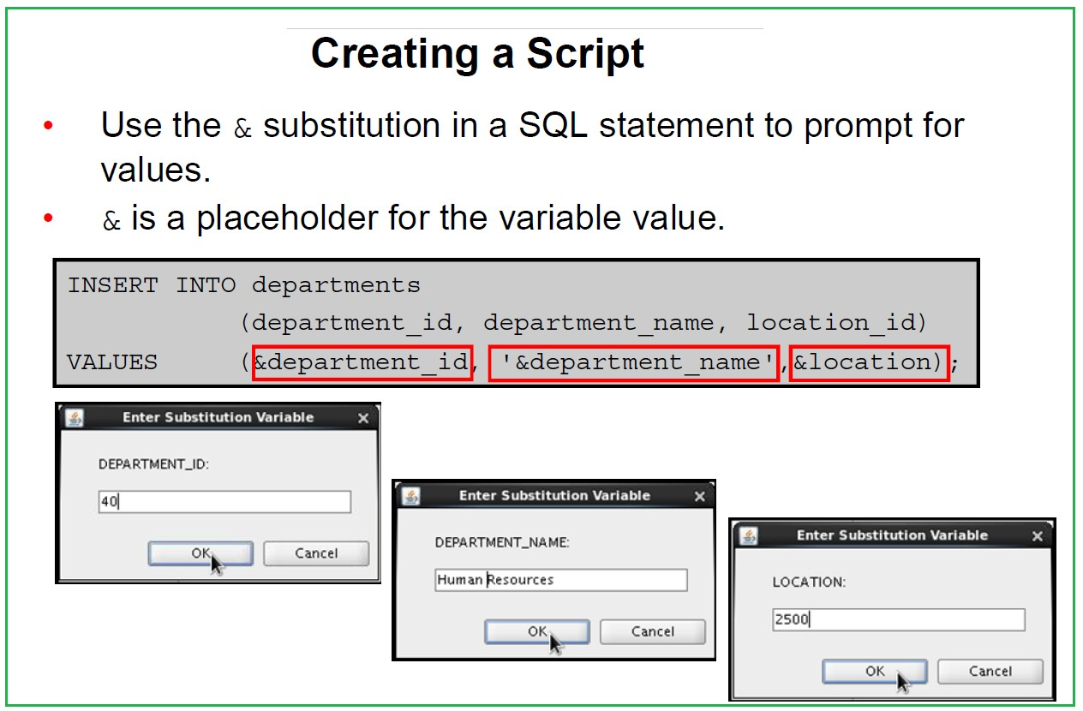

Slide 13
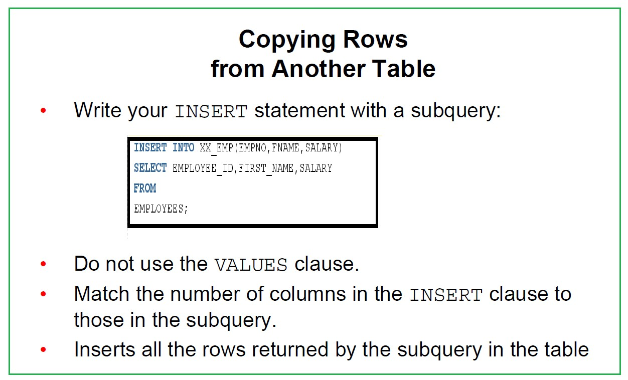

Slide 14
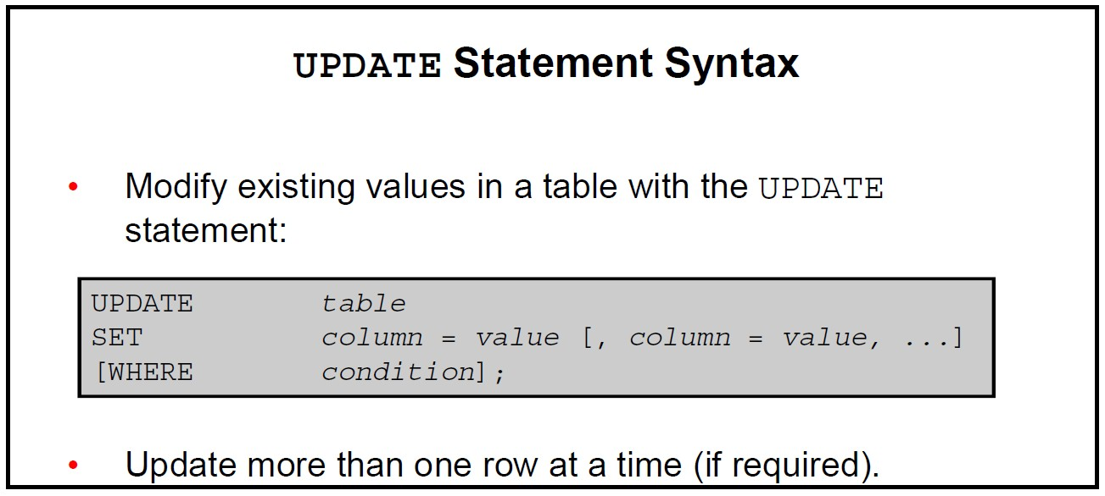

Slide 15
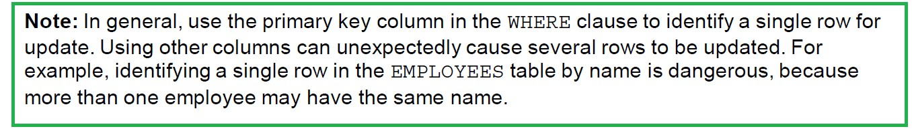
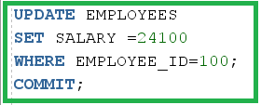
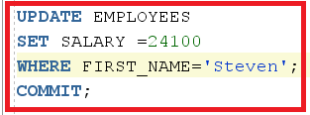
you guarantee one row update
could be more than one employee with name='Steven'

Slide 16

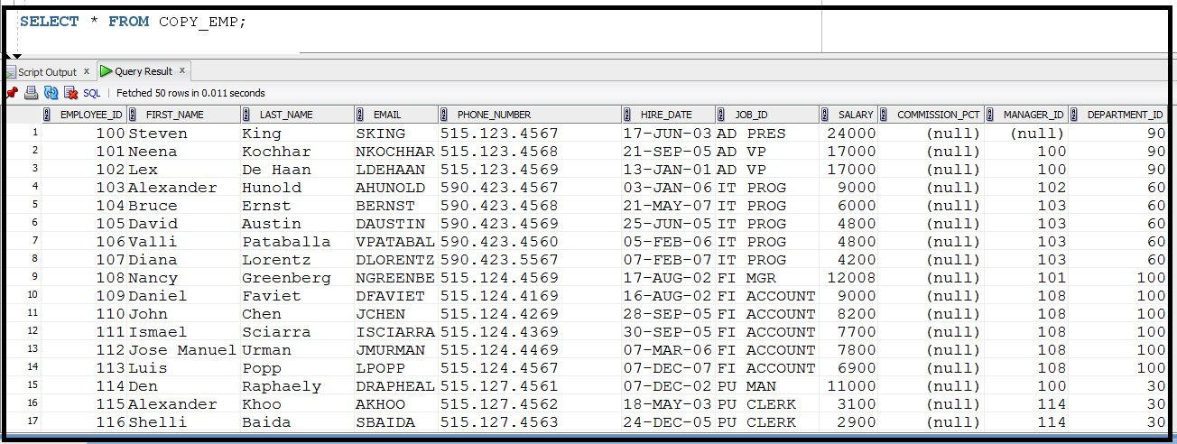
In order to do more practices lets create table called copy_emp And this table will be a copy from employees table To do this, we will execute the following SQL:
This will create table exactly like employees , but without creating the constraints like employee table, expect not null constraints

Slide 17
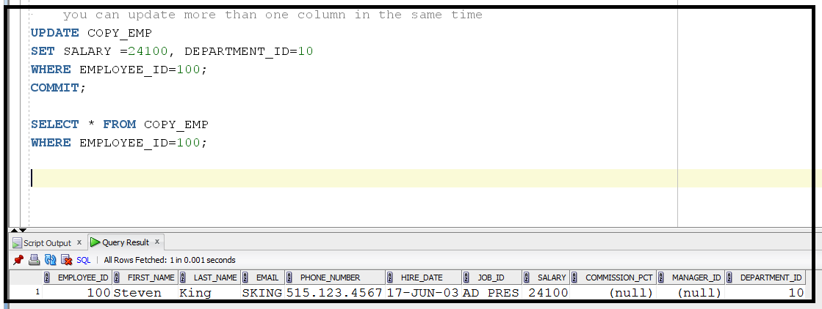
Updating more than one column in the same time
Use comma (, ) followed by column name

Slide 18
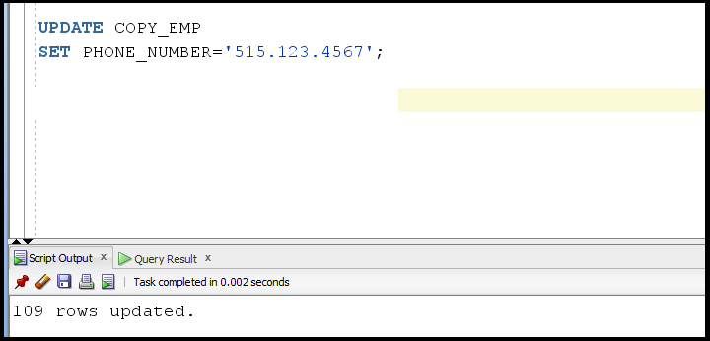
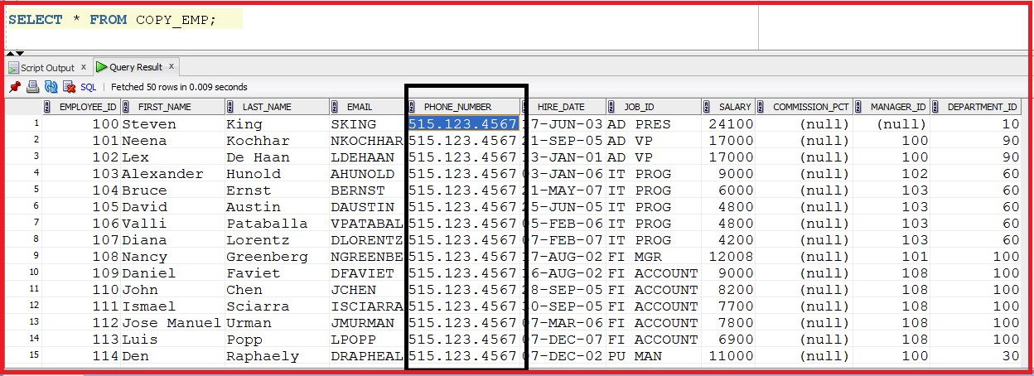
IF there is no where condition then the statement will update all the tables

Slide 19
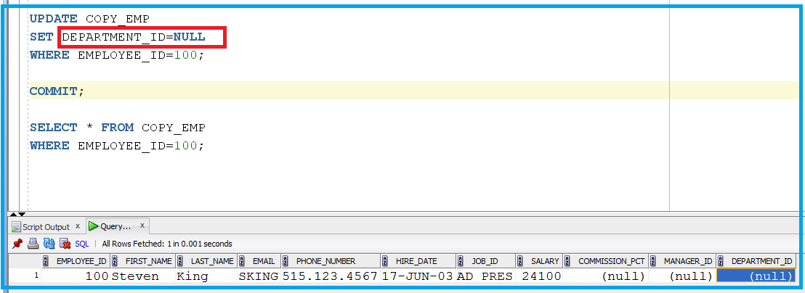
You can set the column to null in the update statement
But there is nothing in select ……..column =null
In select we use column is null/ column is not null

Slide 20
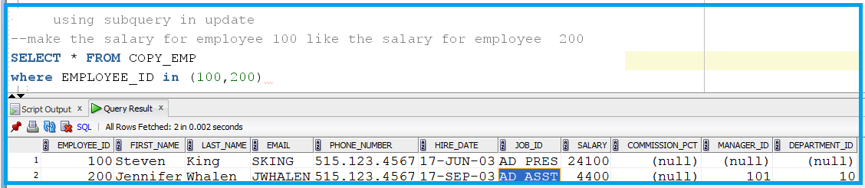
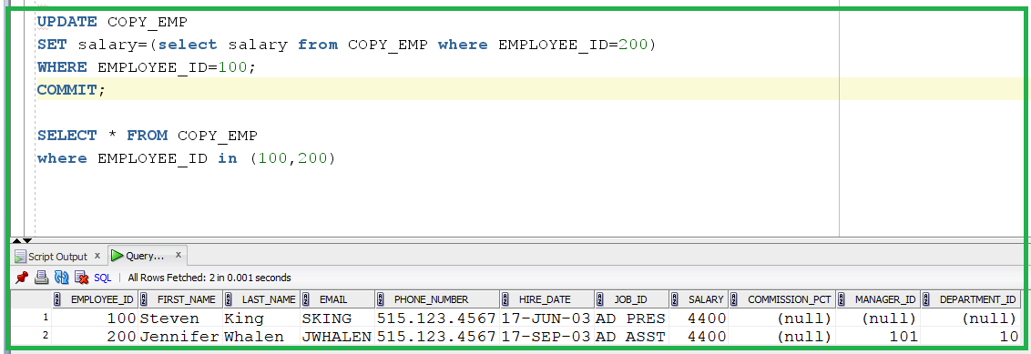
Using Subquery in Update

Slide 21
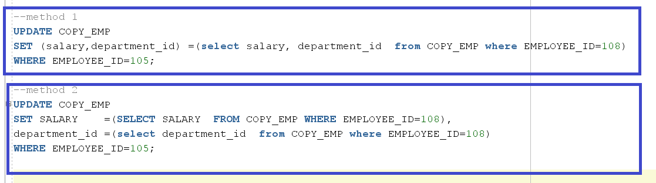
Using Subquery in Update
make the salary and department id for employee 105 like the salary and department id for employee 108

Slide 22
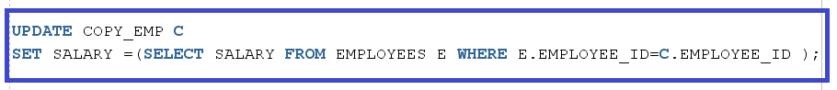
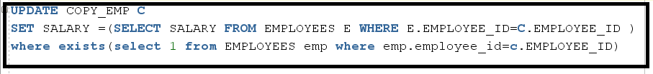
Update based on another table
Make all the salaries in table copy_emp like the salaries in table employees
In this case the additional rows in table copy_emp that doesn’t meet the conditions will be updated by null values.
When there is no where in the SQL statement this mean all rows will be updated

Slide 23
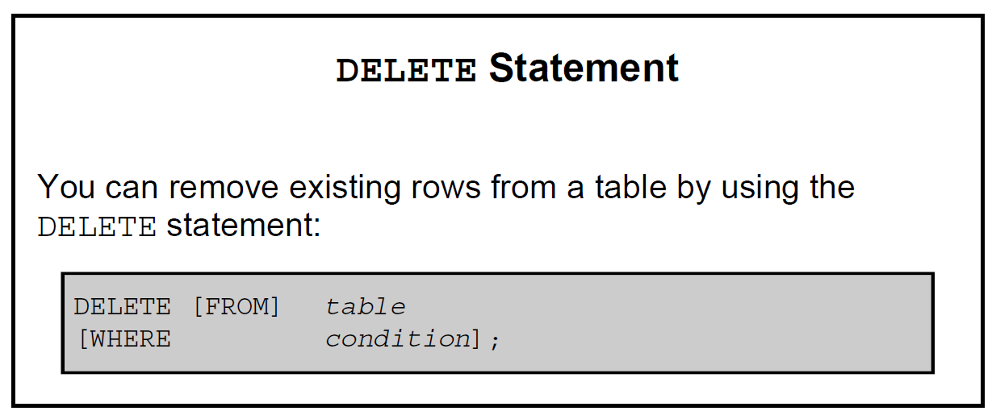

Slide 24
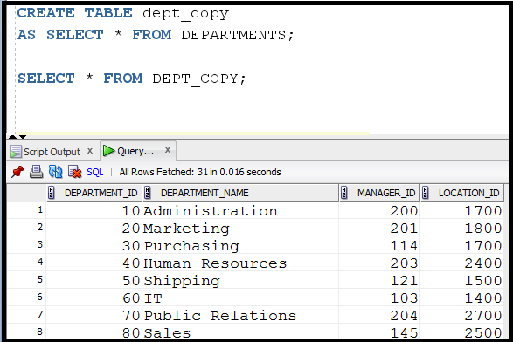
We will create table dept_copy in order to do some practices
Note: dept_copy table will have no constraints (PK,FK,..)
Because create table based on select doesn’t copy any constraint like PK,FK But it make copy for not null constraints

Slide 25
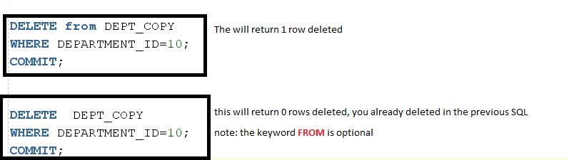
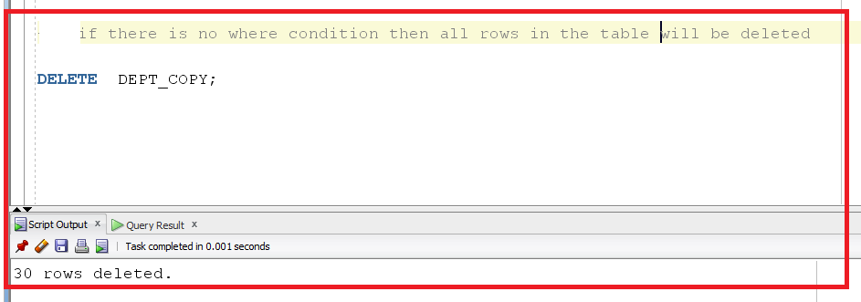
You can rollback this update, but before doing commit,
If you do commit, then you can not do rollback

Slide 26
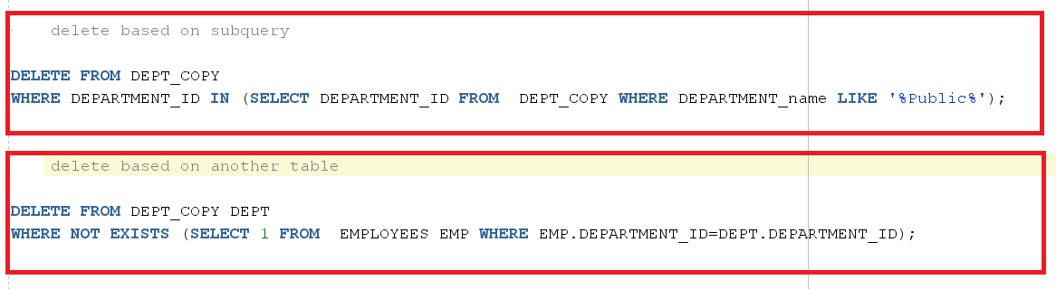

Slide 27
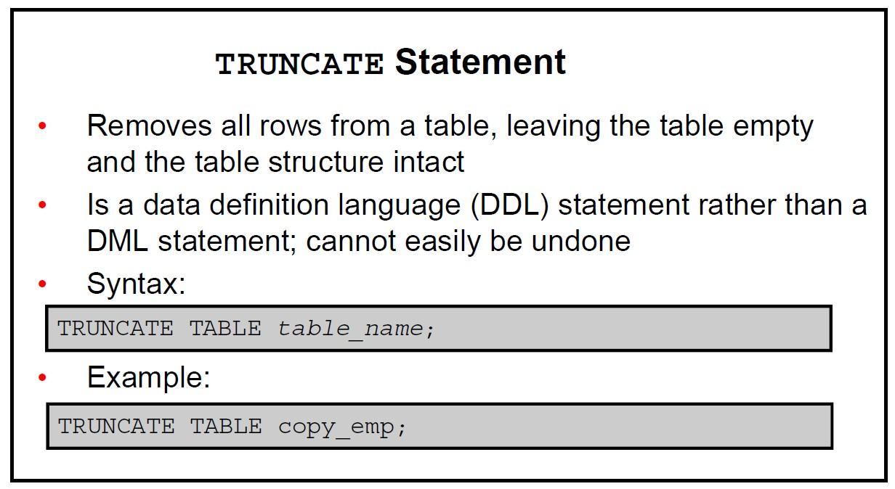

Slide 28
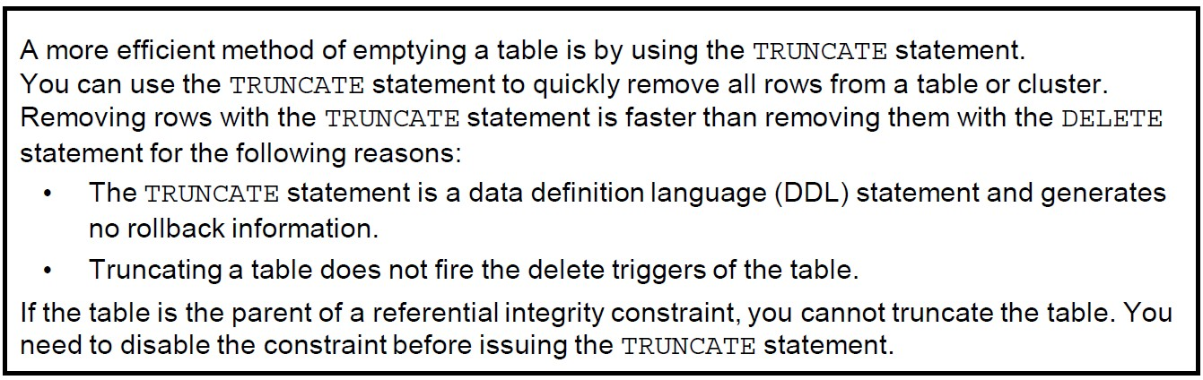

Slide 29
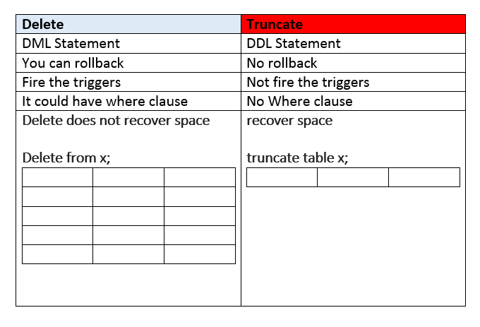

Slide 30
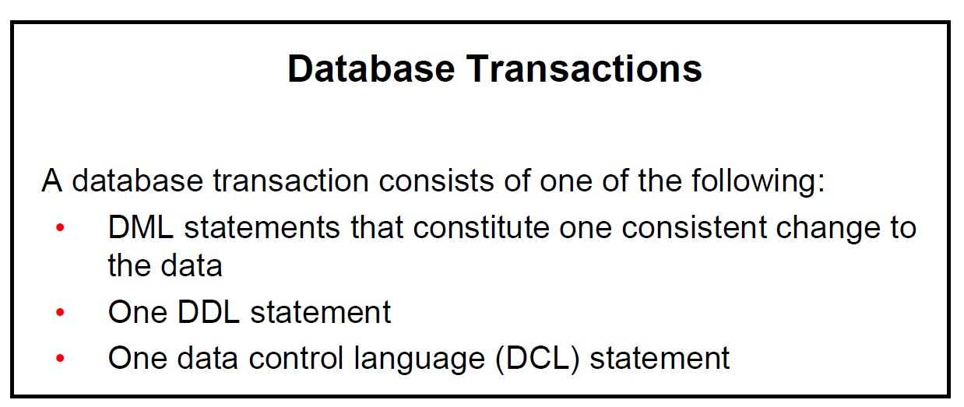

Slide 31
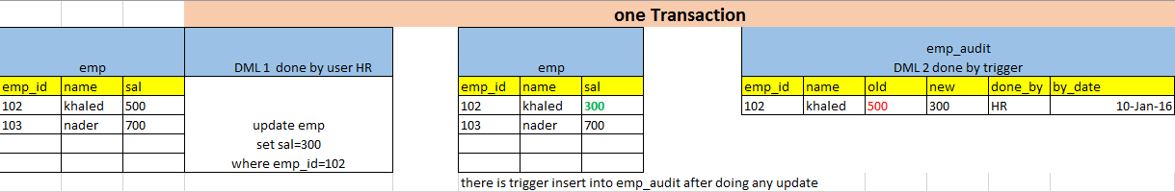
Example1: DML statements from one transaction
Example2: DDL statement ( one transaction )
Create table emp_copy as select * from employees
Example3: DCL statement ( one transaction ) Grant select on hr.employees to scott

Slide 32
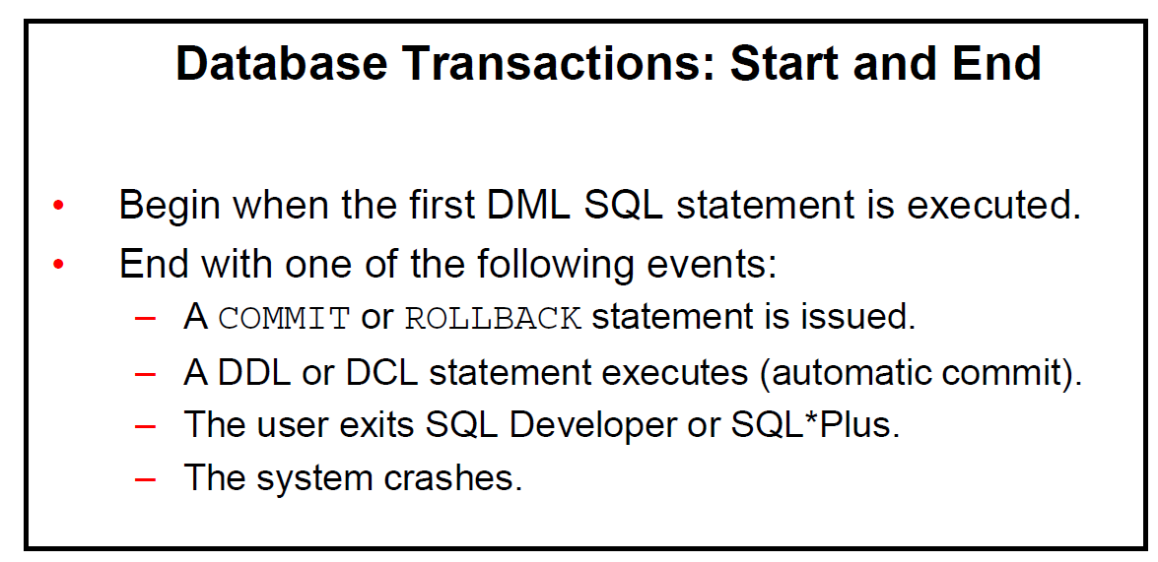

Slide 33
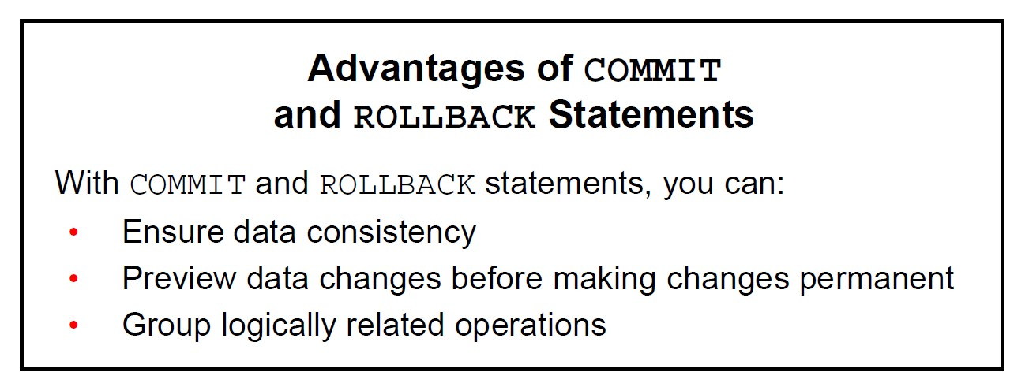

Slide 34
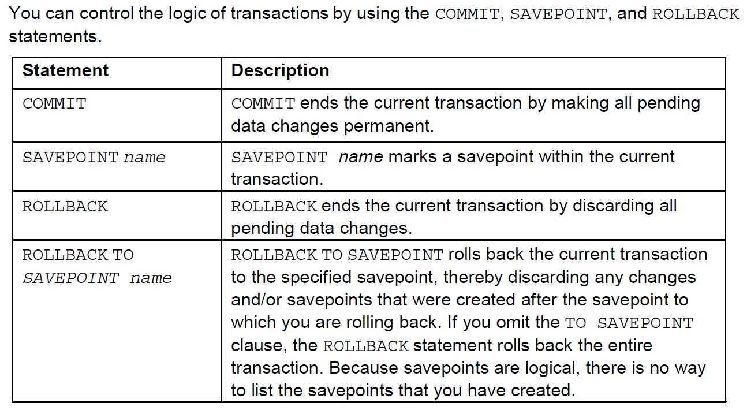

Slide 35
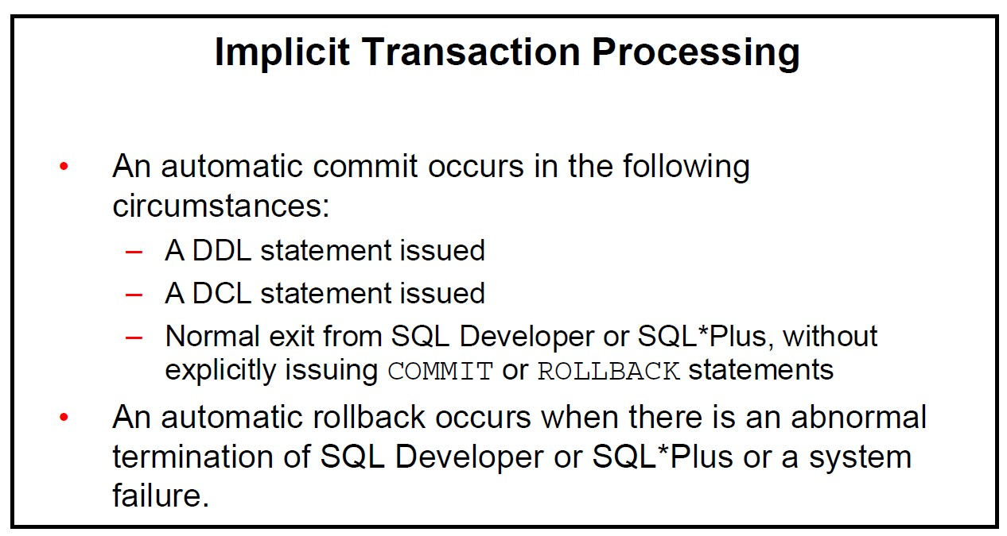

Slide 36
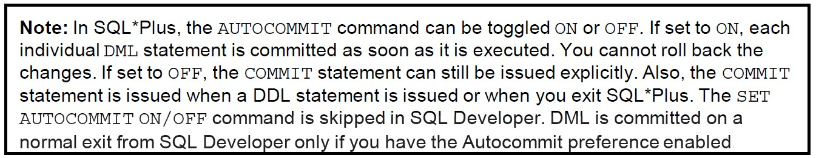
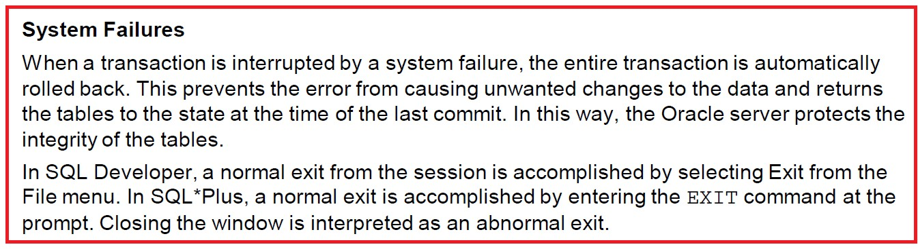

Slide 37
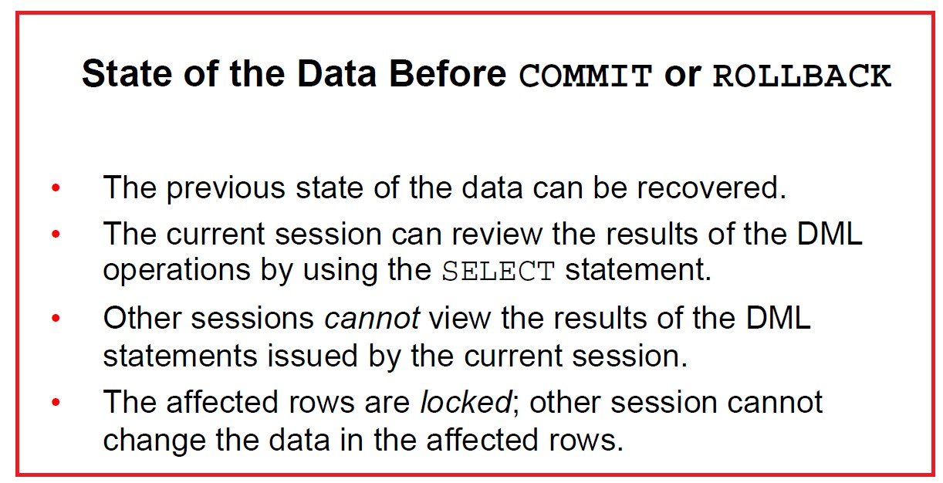

Slide 38
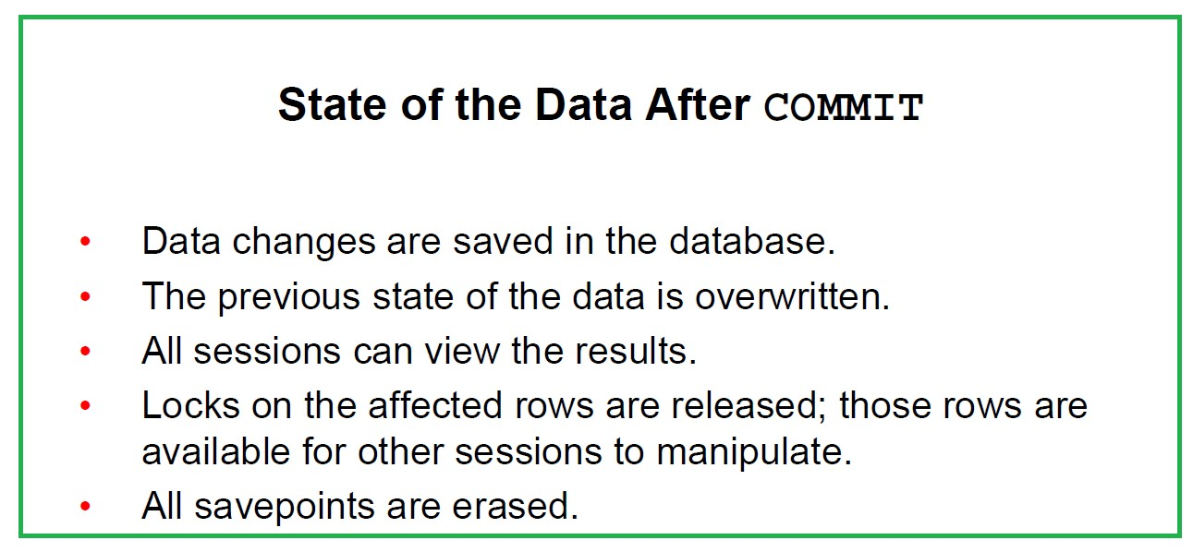

Slide 39
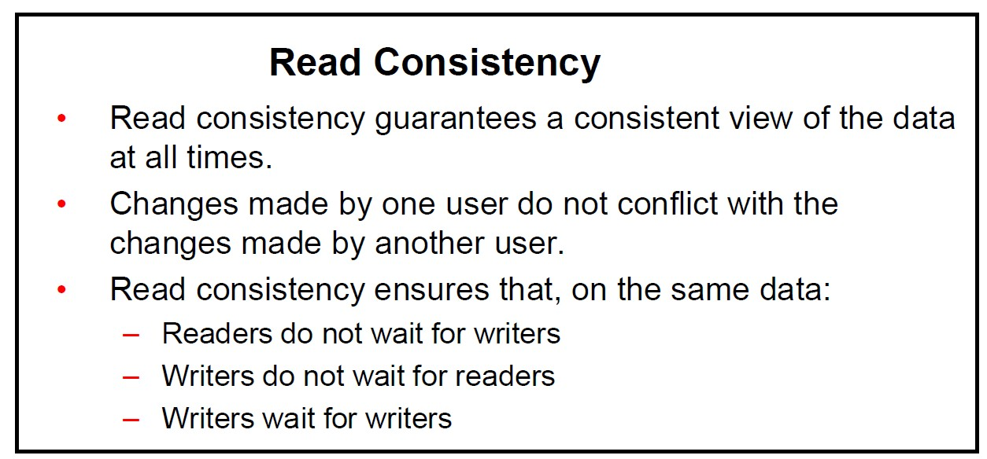

Slide 40
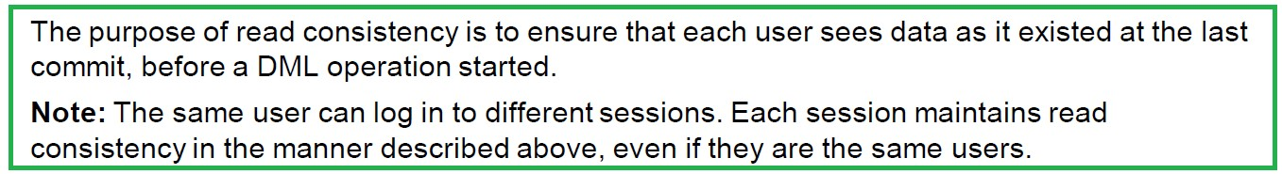

Slide 41
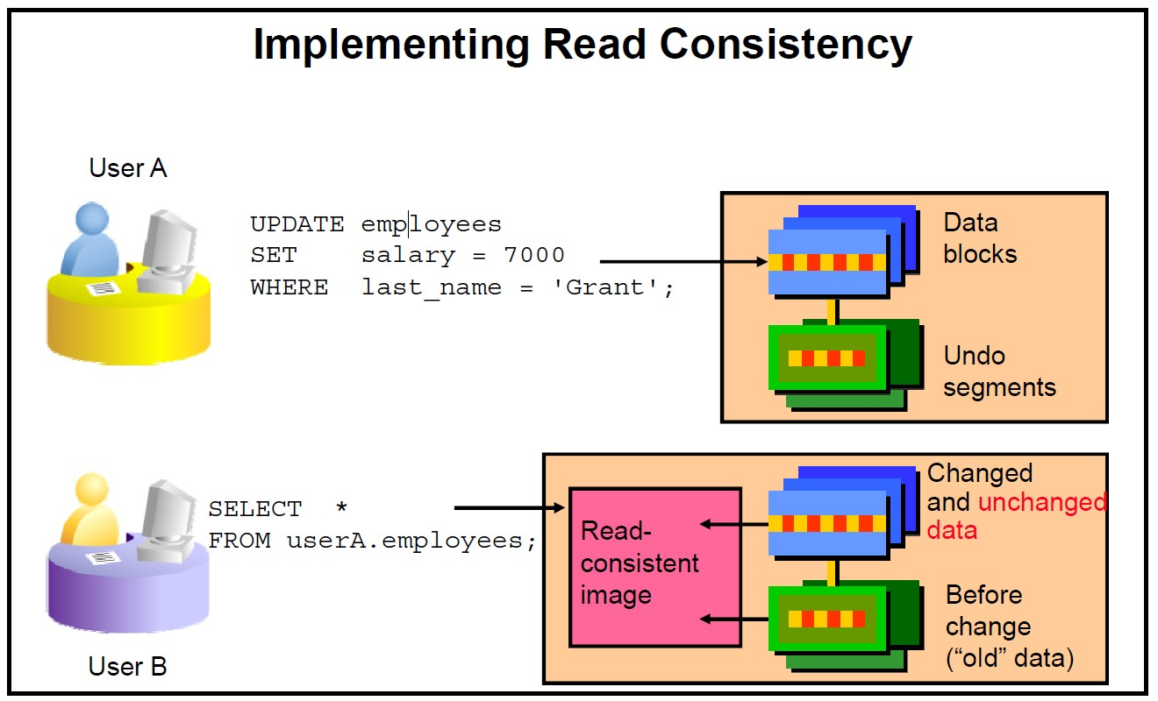

Slide 42
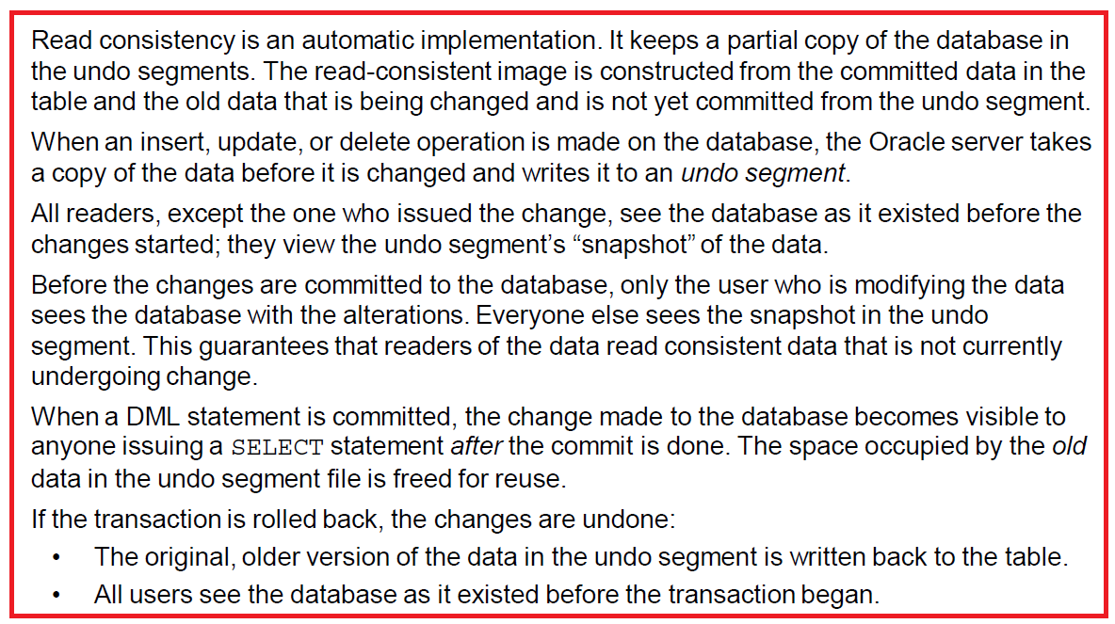

Slide 43
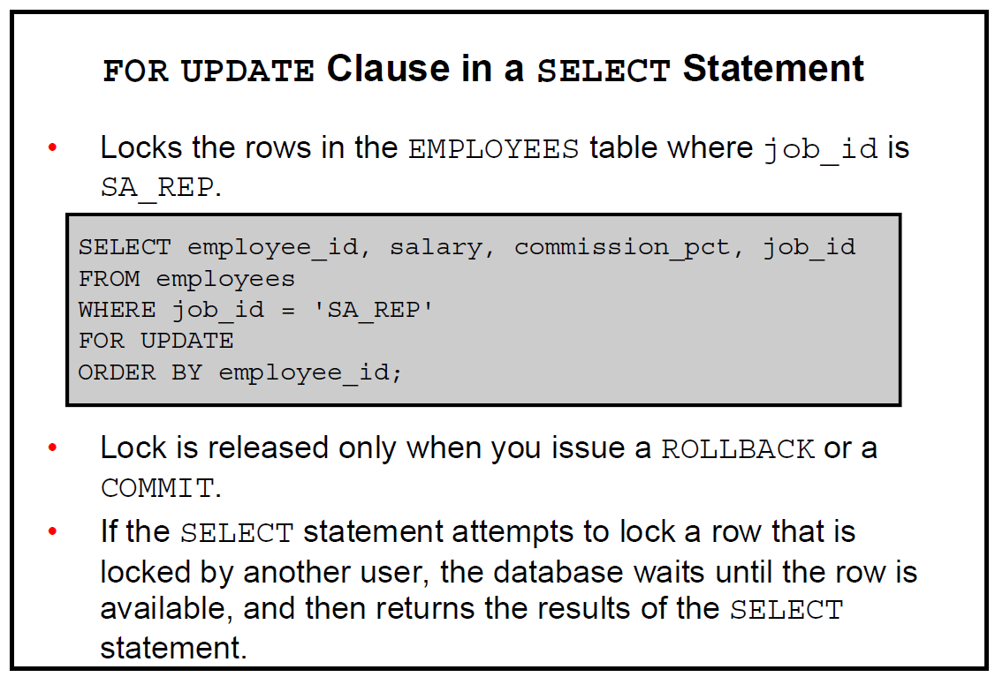

Slide 44
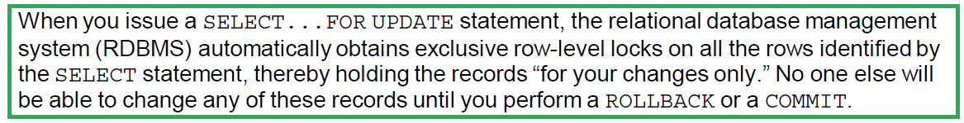

Slide 45
Thank You
Prepared By :Khaled AlKhudari
36

